Slide 1
Python programming
unit 4a – filter, map, reduce, lambda, decorator

Slide 2
lambda
Python can define a unnamed function with lambda statement.
Defines a function, takes one argument, return the Boolean value of judgement if the value can be divided by 2
Defines a function, takes 2 arguments, return the Boolean value of judgement if the distance between (x,y) and (0,0) is less than 1 (points inside the unit circle)

Slide 3

filter
Filter takes an iterable and filter items according to a condition test. The test can be a normal function return True or False, or lambda function return True or False
Filter only items which is even, then make a new list with the selected items
Filter only those string items start with ‘a’, then make a new list with the selected items.
Notice that lambda can call other functions.

Slide 4
Map
Map take an iterable and map all items of the iterable to a new value according to the mapping rule.
For each item in l1 list, calculate the new item value as x squared, then make the new list of all new items.
For each item in l2 list, count how many time it appeared in the list, then make new list with all the counted values.

Slide 5
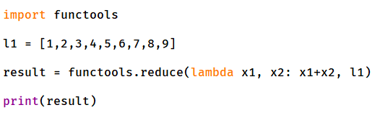
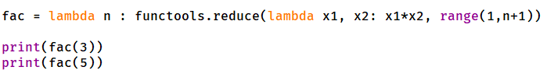
reduce
Apply a function (or callable) to the first two items in an iterable and generate a partial result.
Use that partial result, together with the third item in the iterable, to generate another partial result.
Repeat the process until the iterable is exhausted and then return a single cumulative value.

Slide 6
Function as parameter
Function is also an object in python.
Function can be used to assign to other names
Function can be used as argument during function call
Can return a local defined function to outside, and then outside program can use it to make function call

Slide 7
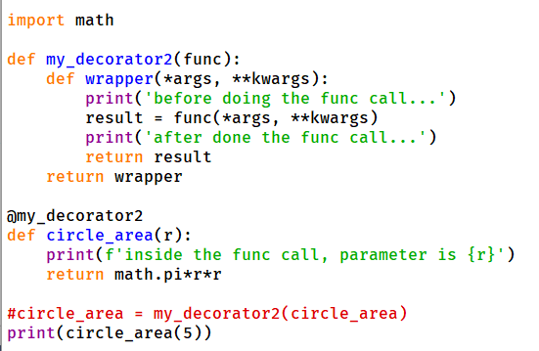
decorator
A decorator is used to modify the original defined function, make some slight changes to it, yet you can still use the same function name to invoke it, but with the new added function.
Normally used decorator syntax
For built-in function, other package function, can use this syntax to decorate.

Slide 8
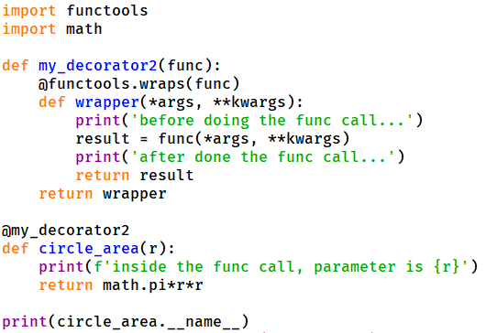
__name__ attribute
Function has an attribute, __name__, which is the name of the function.
Decoration will not change this attribute, so the decorated function if look at this attribute will find the real wrapper function name.
Use functools.wraps() to deal with it.

